Slide 1

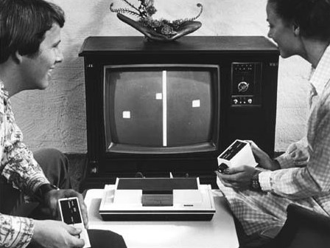
8. Pong
Let’s Learn
Aj. Andrew Davison, CoE, PSU Hat Yai Campus
E-mail: ad@fivedots.coe.psu.ac.th

Slide 2
Outline
beachBounce.py Reused
Pong in Action
The main Code
The BlockSprite Class
The Paddle Class
The BallSprite Class

Slide 3
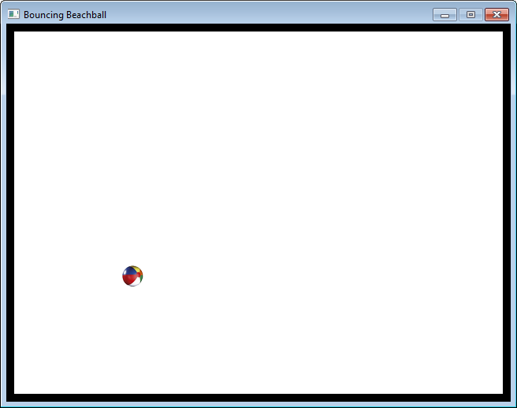
1. beachBounce.py Reused
The Pong game can reuse lots of code and sprites from beachBounce.py
BlockSprite, BallSprite, and most of the main code

Slide 4
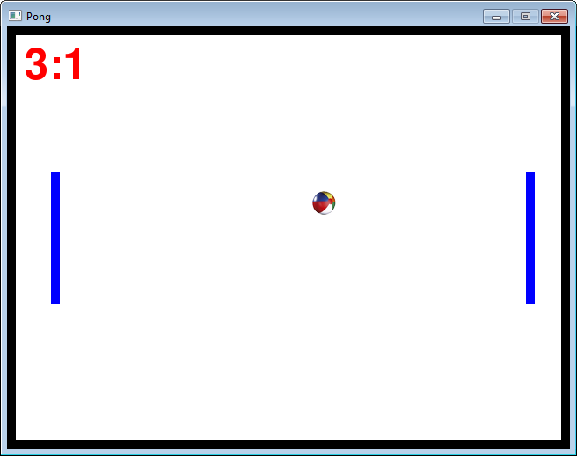
2. Pong in Action
each game 'thing' == a sprite object
4 BlockSprites
for the 4 walls
2 Paddle
sprites
(new)
1 BallSprite

Slide 5
The score text could be a sprite, but I've decided to code it as extra variables inside main.

Slide 6
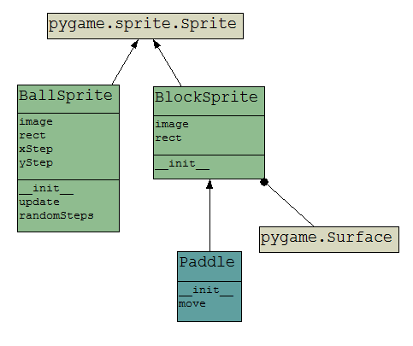
pong.py Classes Picture
inherits
variables
uses
functions
inherits
Generated using pyNSouceGUI.exe from http://www.andypatterns.com/index.php/ products/pynsource/

Slide 7
3. The main Code
# some colors
BLACK = ( 0, 0, 0)
WHITE = ( 255, 255, 255)
RED = ( 255, 0, 0)
GREEN = ( 0, 255, 0)
BLUE = ( 0, 0, 255)
WALL_SIZE = 10
STEP = 8
PADDLE_STEP = 10
LEFT = 0
RIGHT = 1
WINNING_SCORE = 5
game constants
(better to have names
than numbers
in the program)

Slide 8
# code for the classes, see later
class BlockSprite(pygame.sprite.Sprite):
:
class Paddle(BlockSprite):
:
class BallSprite(pygame.sprite.Sprite):
:
# -----------------------------------
# function(s) used by main
def centerImage(screen, im):
x = (scrWidth - im.get_width())/2
y = (scrHeight - im.get_height())/2
screen.blit(im, (x,y))

Slide 9
# main
pygame.init()
screen = pygame.display.set_mode([640,480])
screen.fill(WHITE)
pygame.display.set_caption("Pong")
scrWidth, scrHeight = screen.get_size()
# create wall sprites
top = BlockSprite(0, 0, scrWidth, WALL_SIZE)
bottom = BlockSprite(0, scrHeight-WALL_SIZE, scrWidth, WALL_SIZE)
left = BlockSprite(0, 0, WALL_SIZE, scrHeight)
right = BlockSprite(scrWidth-WALL_SIZE, 0, WALL_SIZE, scrHeight)
horizWalls = pygame.sprite.Group(top, bottom)
vertWalls = pygame.sprite.Group(left, right)
# create two paddles
leftPaddle = Paddle(50, scrHeight/2)
rightPaddle = Paddle(scrWidth-50, scrHeight/2)
ball = BallSprite('smallBall.png')
sprites = pygame.sprite.OrderedUpdates(top, bottom, left, right,
leftPaddle, rightPaddle, ball)
Usual initialization stuff;
scrWidth, scrHeight are usually very useful
Create the sprite objects
and groups

Slide 10
# game variables
leftStep = 0; rightStep = 0
# move step in pixels for paddles
scoreLeft = 0; scoreRight = 0
winMsg = ""
gameOver = False
font = pygame.font.Font(None, 72)

Slide 11
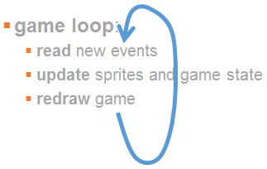
clock = pygame.time.Clock()
running = True
while running:
clock.tick(30)
# handle events
for event in pygame.event.get():
if event.type == QUIT:
running = False
if event.type == KEYDOWN:
if event.key == K_q: # left paddle
leftStep = -PADDLE_STEP # up
elif event.key == K_s:
leftStep = PADDLE_STEP # down
if event.key == K_p: # right paddle
rightStep = -PADDLE_STEP # up
elif event.key == K_l:
rightStep = PADDLE_STEP # down
elif event.type == KEYUP:
if event.key == K_q or event.key == K_s: # left paddle
leftStep = 0
if event.key == K_p or event.key == K_l: # right paddle
rightStep = 0

Slide 12
# update game
if not gameOver:
leftPaddle.move(leftStep)
rightPaddle.move(rightStep)
ball.update()
if scoreLeft >= WINNING_SCORE:
winMsg = "Left Wins!"
gameOver = True
elif scoreRight >= WINNING_SCORE:
winMsg = "Right Wins!"
gameOver = True
# redraw
screen.fill(WHITE)
sprites.draw(screen);
screen.blit( font.render(str(scoreLeft) + ":" +
str(scoreRight), True, RED), [20, 20])
if gameOver:
centerImage(screen, font.render(winMsg, True, RED))
pygame.display.update()
pygame.quit()

Slide 13

Paddle Keys
There are two paddles
left paddle up and down uses 'q' and 's'
right paddle up and down uses 'p' and 'l'
q
p
s
l

Slide 14
Repeating Key Action
If the user holds down a key then the paddle keeps moving until the user releases the key.
very common game behaviour
Implemented by checking for KEYDOWN and KEYUP events for the key
KEYDOWN sets the move step (e.g. to 10 or -10)
KEYUP resets the step to 0

Slide 15
Finishing the Game ≠ Finishing the Program
The code uses two booleans (True/False):
running and gameOver
running is used to end the game loop and program
gameOver means that the user's game is finished, but not the game loop
When gameOver is true, the game loop must continue in order to show things (e.g. the winner's message)
gameOver is also used to skip the game update

Slide 16
4. The BlockSprite Class
The same as before – it's used to represent a non-moving sprite that looks like a coloured rectangle.
class BlockSprite(pygame.sprite.Sprite):
def __init__(self, x, y, width, height, color=BLACK):
super().__init__()
self.image = pygame.Surface((width, height))
self.image.fill(color)
self.rect = self.image.get_rect()
self.rect.topleft = (x, y)

Slide 17
5. The Paddle Class
This can be coded as a moving version of my BlockSprite class
so Paddle inherits BlockSprite, which inherits Sprite
see slide 6
The extra code in Paddle is a move() function that allows the sprite to move up or down
but moving must stop when the paddle is at the top or bottom of the window

Slide 18
class Paddle(BlockSprite):
def __init__(self, x, y):
super().__init__(x, y-75, 10, 150, BLUE)
# paddle width & height
def move(self, step):
if pygame.sprite.collide_rect(self, top)
and (step < 0): # at top & going up
step = 0
elif pygame.sprite.collide_rect(self, bottom)
and (step > 0): # at bottom and going down
step = 0
self.rect.y += step

Slide 19
Collision Testing
Usually colllision testing uses a sprite collision function and a direction test
the direction is used to see if the thing is moving towards or away from the collision
direction ==
a collision
direction ≠
a collision

Slide 20
6. The BallSprite Class
The hardest part of this class is coding update() which moves the ball.
Normally the move is xStep in the x-direction and yStep in the y-direction, but...
what happens when the ball hits:
the left paddle?
the right paddle?
the horizontal walls (i.e. the top and bottom sides)?
the vertical walls (i.e. the left and right sides)?

Slide 21
class BallSprite(pygame.sprite.Sprite):
def __init__(self, fnm):
super().__init__()
self.image = pygame.image.load(fnm).convert_alpha()
self.rect = self.image.get_rect()
self.rect.center = [scrWidth/2, scrHeight/2]
# start position of the ball in center of window
self.xStep, self.yStep = self.randomSteps()
# step size and direction along each axis
def randomSteps(self):
# create a random +/- STEP pair
x = STEP
if random.random() > 0.5:
x = -x
y = STEP
if random.random() > 0.5:
y = -y
return [x,y]

Slide 22
def update(self):
global scoreLeft, scoreRight
if pygame.sprite.collide_rect(self, leftPaddle) and (self.xStep < 0):
# hit left paddle and going left
self.xStep = -self.xStep # change direction
elif pygame.sprite.collide_rect(self,rightPaddle) and (self.xStep>0):
# hit right paddle and going right
self.xStep = -self.xStep # change direction
if pygame.sprite.spritecollideany(self, horizWalls):
# change y-step direction at top and bottom sides
self.yStep = -self.yStep
if pygame.sprite.spritecollideany(self, vertWalls):
# ball has reached left or right sides
if pygame.sprite.collide_rect(self, right):
scoreLeft += 1
else: # left side
scoreRight += 1
# reset the ball
self.rect.center = (scrWidth/2, scrHeight/2)
self.xStep, self.yStep = self.randomSteps()
self.rect.x += self.xStep # move the ball horizontally
self.rect.y += self.yStep # and vertically

